Slide 1
Retinopathy of Prematurity screening and management
06/12/2014
Chhour Long MD
ophthalmologist

Slide 2
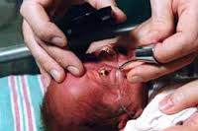
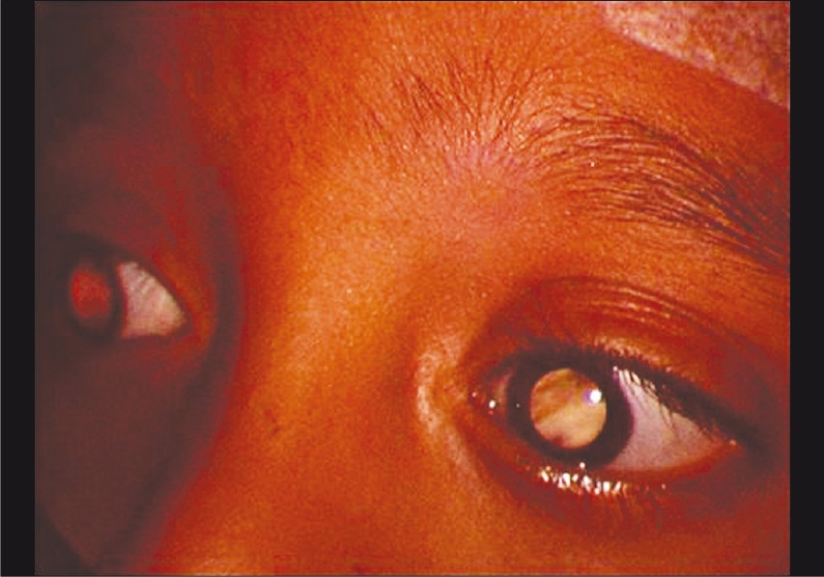
What is ROP?

Slide 3
Introduction
ROP is an ischemic retinopathy of premature and low birth weight infants.
First identified by Terry in 1942 as RLF.
Out come of ROP px range from minimal sequelae with no effect on vision in mild case up to bilateral irreversible total blindness in more advanced cases.

Slide 4
In USA, ROP cause some degree of vision loss approximately 1300 children born each year and 250-500 of these have severe visual impairement.
300/1mi lives births have at least one eye blinded by ROP.

Slide 5
Pathogenesis and Risk factors
Normal retinal vascularization proceeds from optic disc to periphery and is complete in nasal quadrants at appx 36w of gestation and 40w on temporal quadrants.
Current understanding of ROP is incomplete, but 2 processes has been suggested for vascularization
1/ vasculogenesis: formation of new vessels by transformation of vascular precursor cells
2/ angiogenesis: budding from existing vessels
Interaction between IGF-1 and VEGF has been studied and proposed to play a role in the pathogenesis of ROP (Hellstrom et al.)

Slide 6
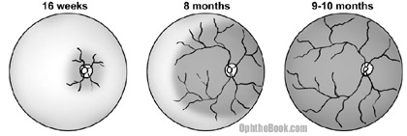

Slide 7
Oxygen’s effect on immature retina
Hyperoxia in the retina will cause retinal vasoconstriction and if sustained will cause some degree of vascular closure and injury to endothelial cells of the most immature vessels.
Nodules of proliferating endothelial cells from residual vascular complexes adjacent to retinal capillaries ablated during hyperoxia canalize to form new vessels that not only grow within the retina, but also erupt through ILM to grow on its surface.

Slide 8
Risk factors
Low birth weight
Short gestational age
Supplement oxygen therapy
Genetic predisposition
Congenital heart disease
Cyanosis
Apnea
Blood transfusion
Septicemia

Slide 9
ICROP
Zone
Extent
Stage
Presence or absence of plus disease

Slide 10
Location
Zone I: posterior retina within 60 degree circle centered on the optic nerve
Zone II: from circle zone I to the nasal ora serrata anteriorly
Zone III: remaining temporal retina

Slide 11
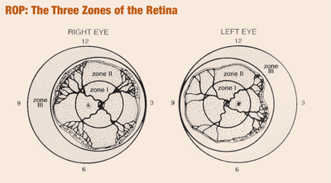
Extent
Described by dividing the retinal surface into 12 segments (clock hours)

Slide 12
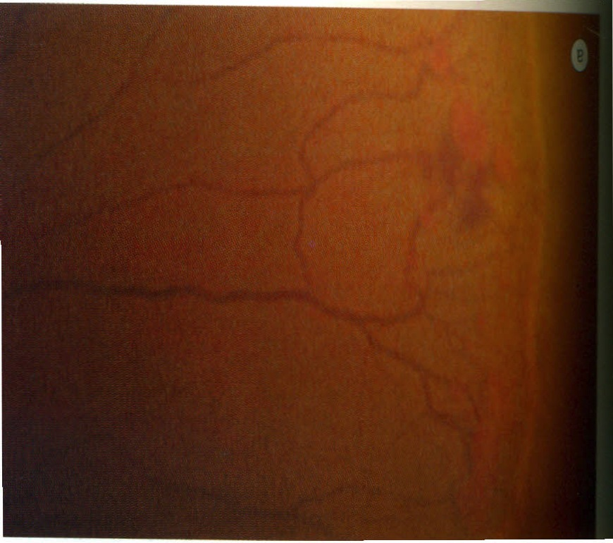
Severity
Stage 1: presence of demarcation line between vascularized and non vascularized retina

Slide 13
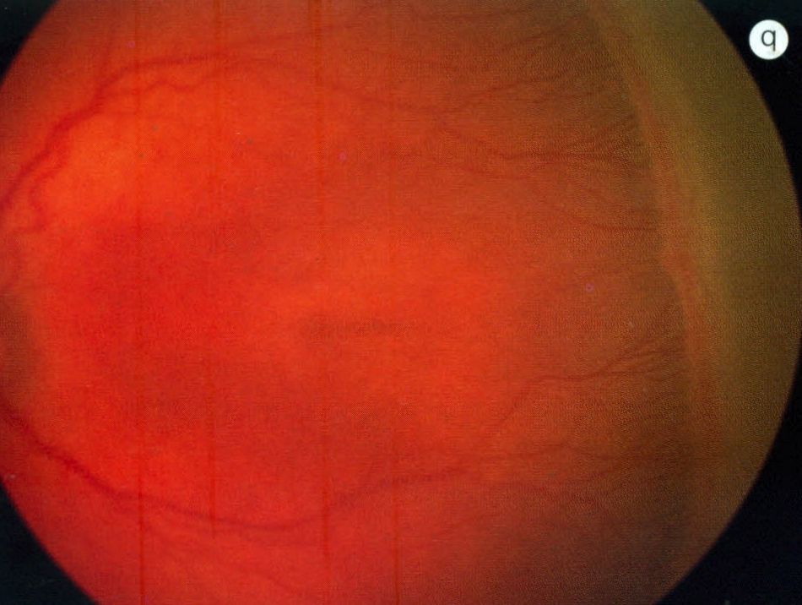
Stage 2: presence of demarcation line that has height, width and volume (ridge)

Slide 14
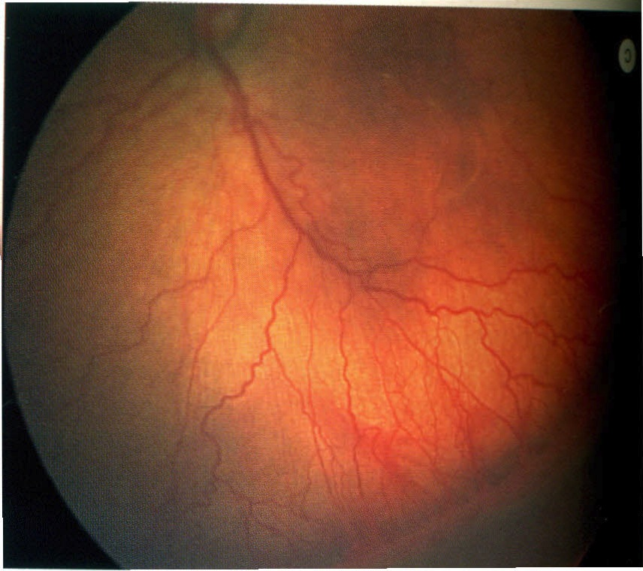
Stage 3: a ridge with extraretinal fibrovascular proliferation

Slide 15
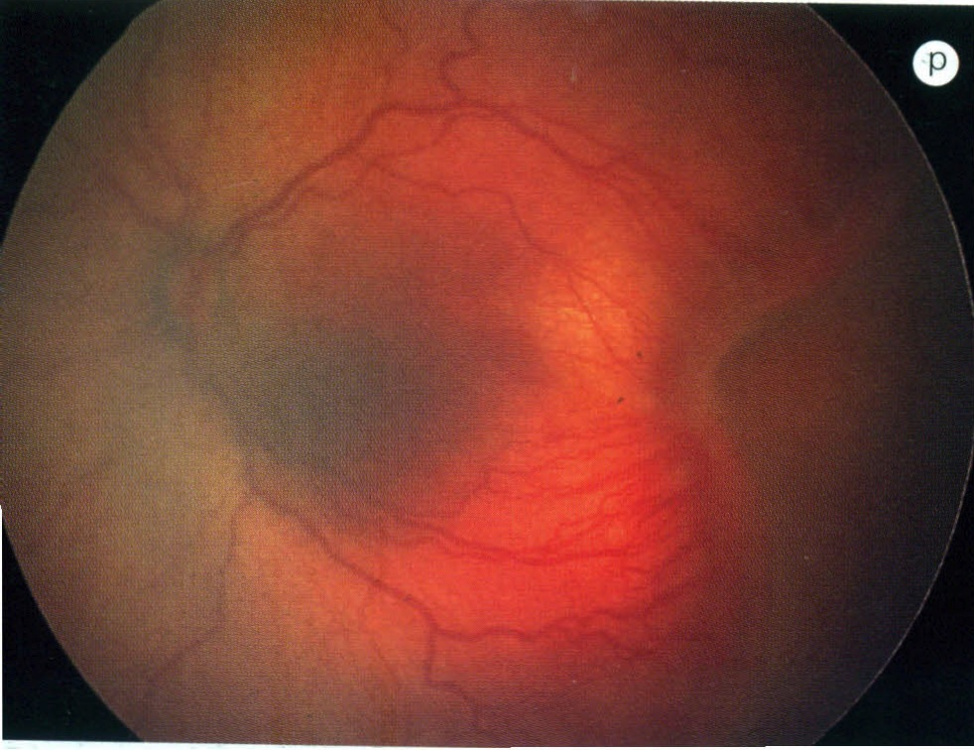
Stage 4
-subtotal RD
4a: extra fovea RD
4b: RD including fovea

Slide 16
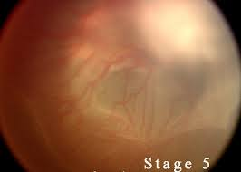
Stage 5: total RD

Slide 17
Plus disease: refer to venous dilatation and arteriolar tortuosity of the posterior retinal vessels in at least two quadrants.
Pre plus: vascular abnormality of the posterior retina that are not sufficient for diagnosis of plus disease.

Slide 18
Threshold disease: defined as at least 5 contiguous or 8 cumulative clock hours of stage 3 ROP in zone I or II in the presence of plus disease.

Slide 19
^{Types of Prethreshold ROP}
^{Type 1 ROP:}
Zone I, any stage with plus disease
Zone I, stage 3 without plus disease
Zone II, stage 2 or 3 with plus disease
^{Type 2 ROP:}
Zone I, stage 1 or 2 without plus disease
Zone II, stage 3 without plus disease

Slide 20
Screening and follow up schedule
Which infants should be screen for ROP?
A joint statement from AAP, AAPOS,AAO
  At least 2 dilated fundus examinations for infant
  Birth Weight <1500 grams or
  Gestational Age ≤ 30 weeks
  unstable clinical course with high risk

Slide 21
Screening guidelines
The first examination performed between 4 to 6 w post natal age or 31st to 33 rd w post menstrual age.
The onset of serious ROP correlates better with postmenstrual age than with post natal age.
Examination generally performed every 1-2w until the retina is fully vascularized.
ROP seen in 66% of infants with BW < 1250g and 82% in those with BW <1000g.

Slide 22
Follow up examination schedule based on retinal findings

Slide 23
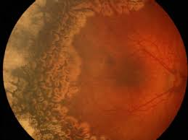
Management
Cryotherapy
Laser photocoagulation
Anti VEGF
Scleral Buckle
Vitrectomy

Slide 24
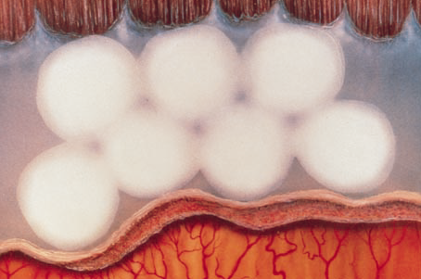
Cryotherapy ablation peripheral retina

Slide 25
CRYO-ROP clinical trial
291 threshold ROP were randomized to treatment with cryotherapy or observation alone. At 15 years of follow-up, 254 children had data available.
Unfavorable visual outcome (20/200 or worse)
  45% of treated eyes and 64% of control eyes (P<.001)
Unfavorable anatomic outcome, defined as posterior retinal fold or retinal detachment involving macula
  30% of treated eyes and 52% of control eyes (P<.001)

Slide 26
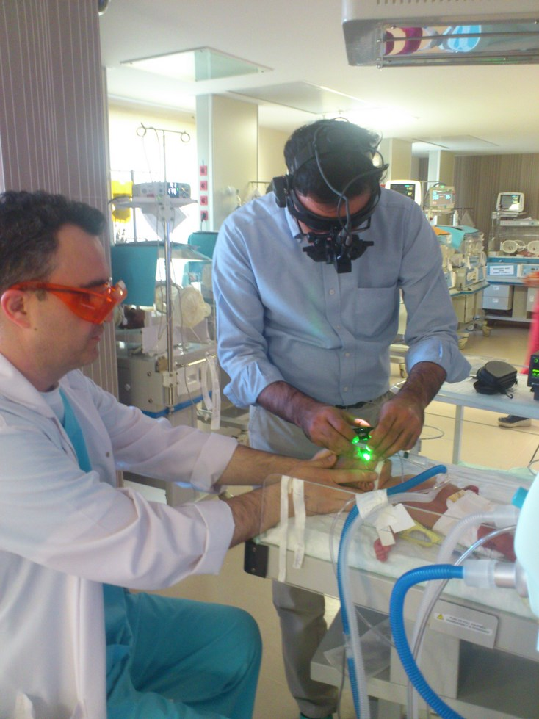
Laser treatment
Laser (diode or argon) is now most commonly used treatment
Should be performed no later than 72 hours after making diagnosis
Retreatment maybe needed if skip areas are indentified or if disease does not show signs of regression

Slide 27
ETROP clinical trial
317 bilateral cases and 84 asymmetric cases reached high-risk prethreshold were randomized to immediate laser treatment or to treat at threshold, after 9 months :
Unfavorable visual outcome
  14.5% in the early treated group versus 19.5% of conventionally managed group
Unfavorable anatomic outcome
  9.1% in the early treated group versus 15.6% in conventionally managed group
Laser treatment at high risk prethreshold would reduce the incidence of unfavorable visual outcome to standard treatment at threshold.

Slide 29
Surgery
Scleral buckle or PPV lens sparing or combine was performed in stage 4 and 5 and the favorable VA after 9 months was found only 13 of 78 eyes and 6 eyes maintained normal VA had stage 4a detachment (Coats).
Capone et al reported normal macular structure in 19/23 eyes and successful retinal reattachments in all eyes after lens sparing vitrectomy for 4A detachments.

Slide 30
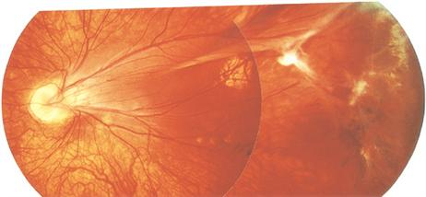
Sequelae of ROP
RD
Macular heterotropia
High myopia
Amblyopia
Strabimus
Glaucoma
Pthisis bulbi

Slide 31
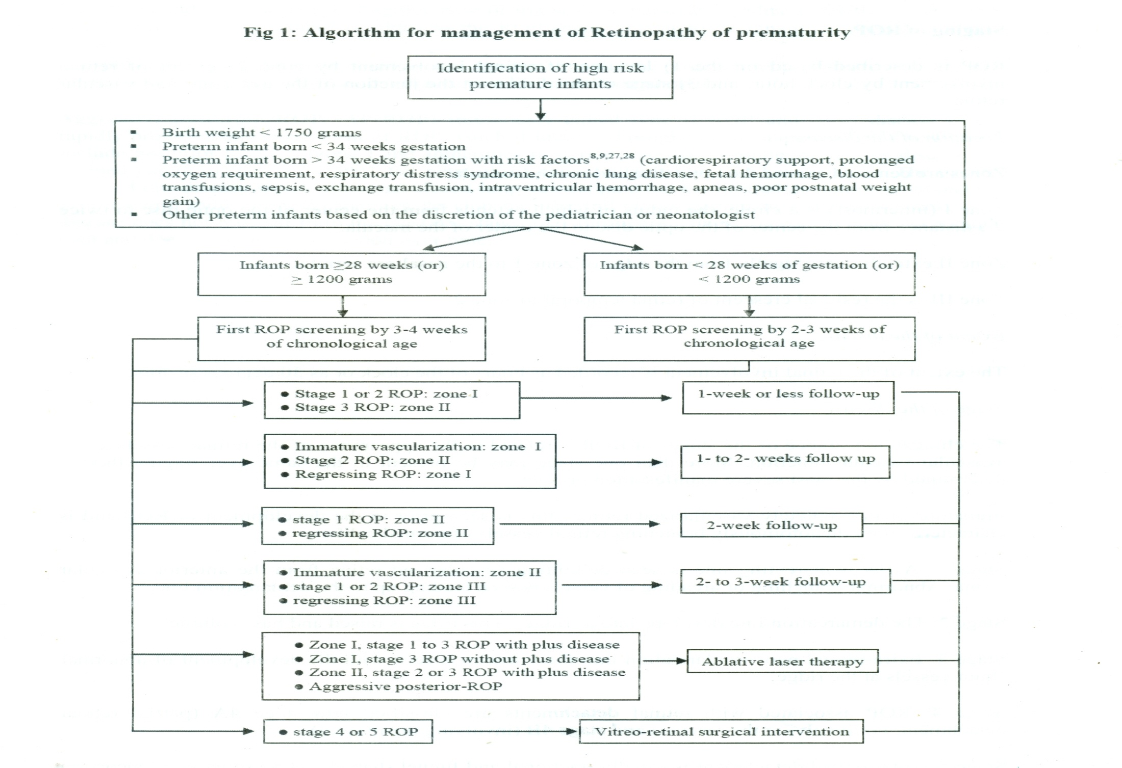

Slide 32
Summary
ROP is one of the preventable childhood blindness disease.
The first retinal examination should be performed not later than 4 weeks of age.
Laser photocoagulation delivered by indirect ophthalmoscopic device is the mainstay of ROP treatment.

Slide 33
Thank you

